Slide 1
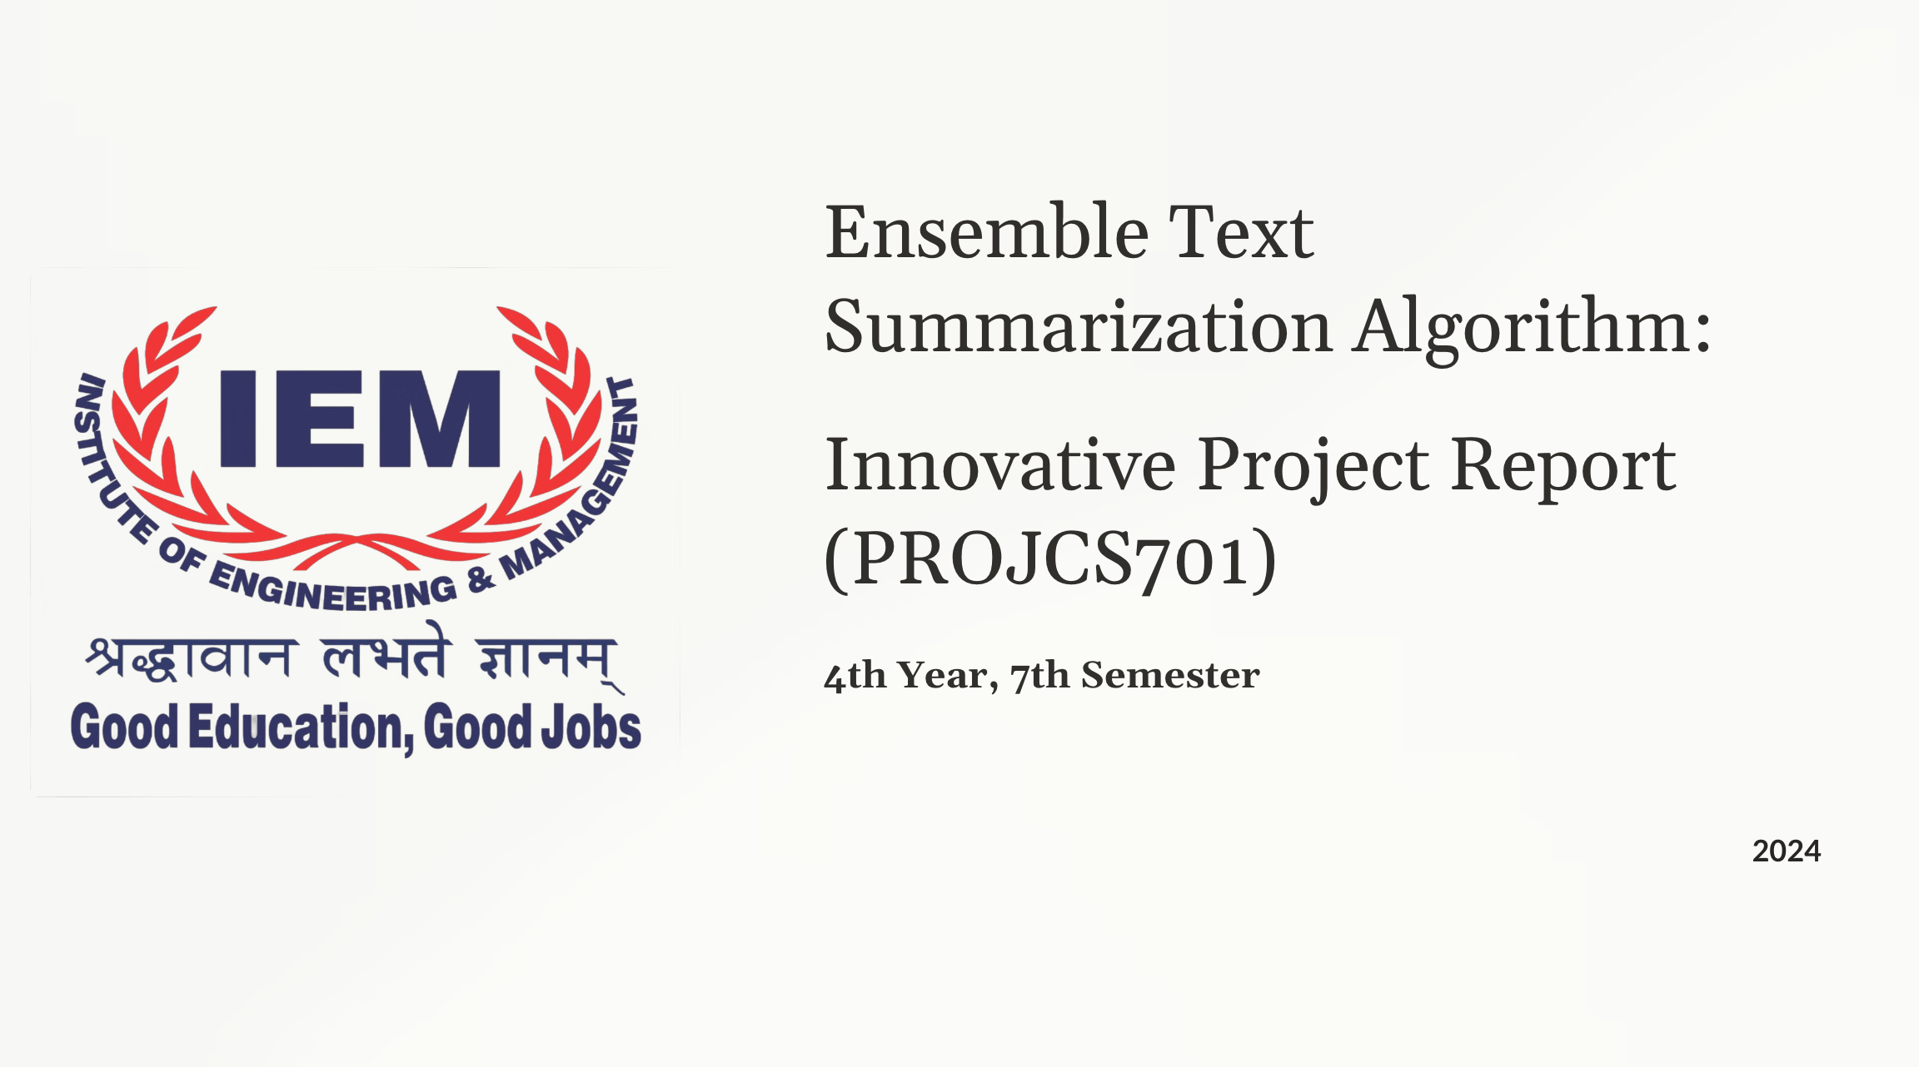
1

Slide 2
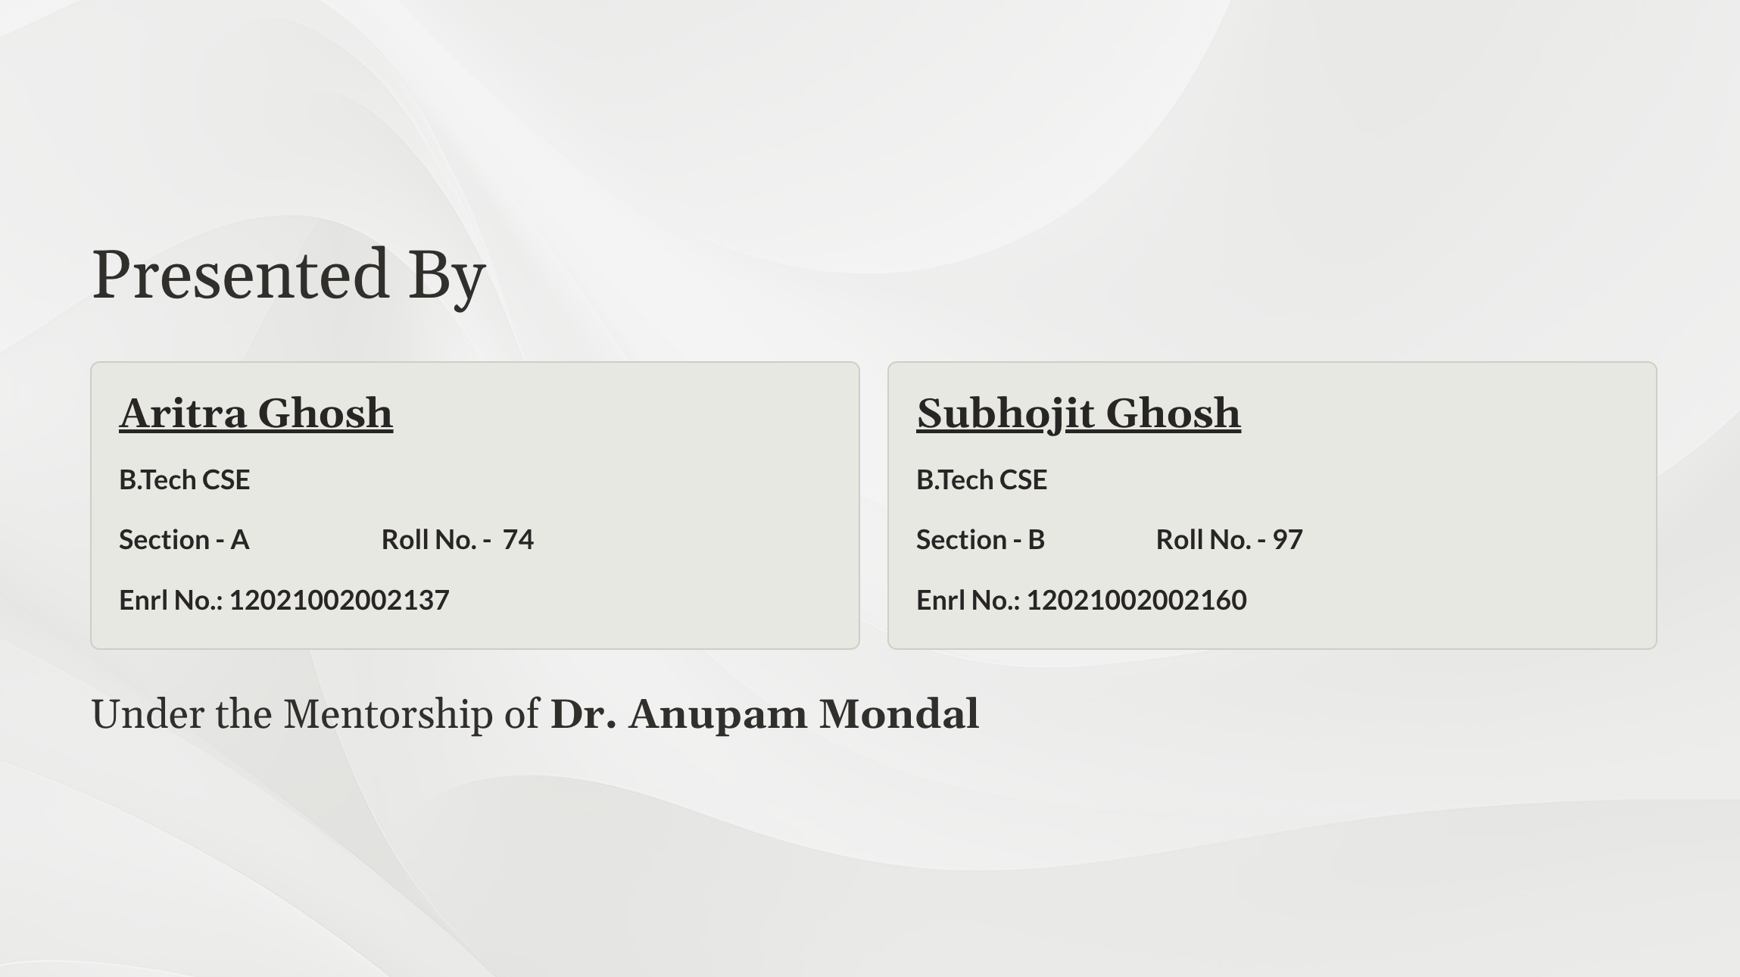
2

Slide 3
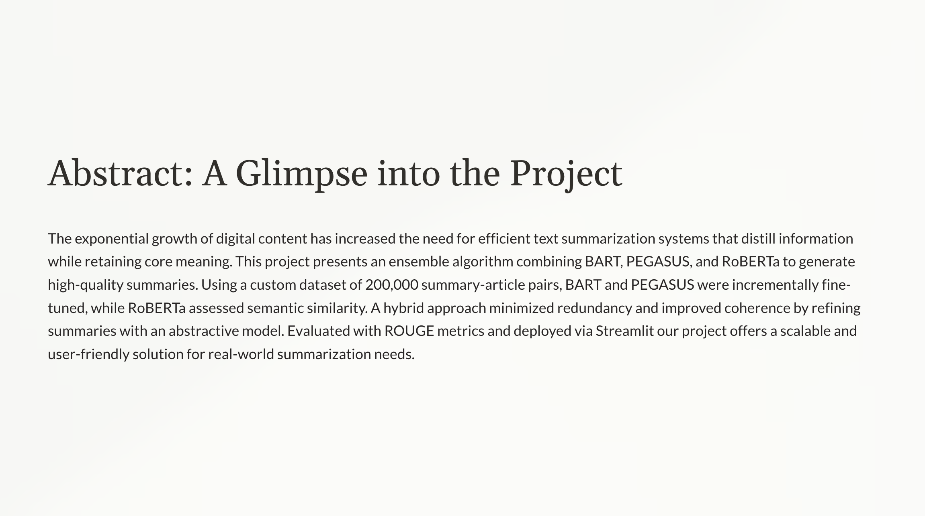
3

Slide 4
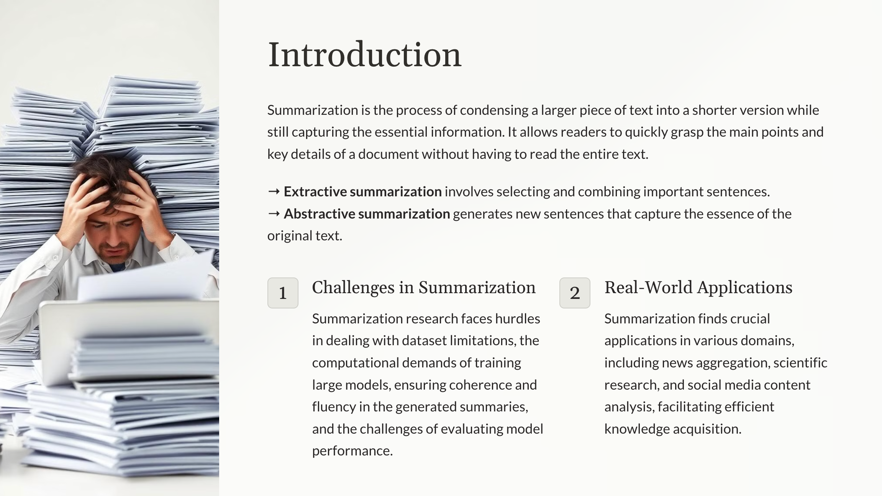
4

Slide 5
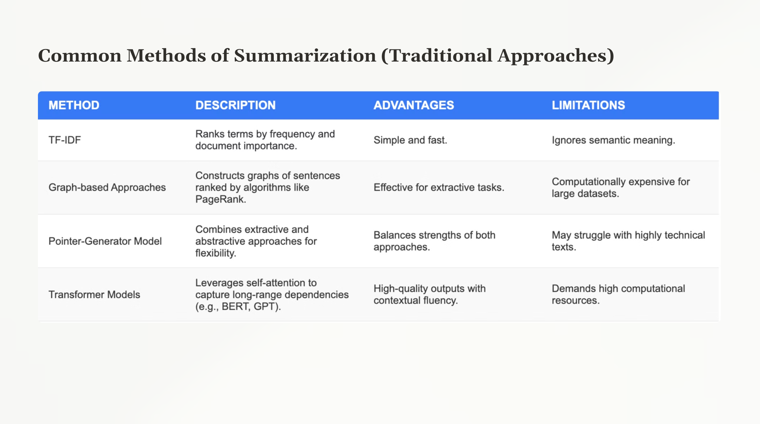
5

Slide 6
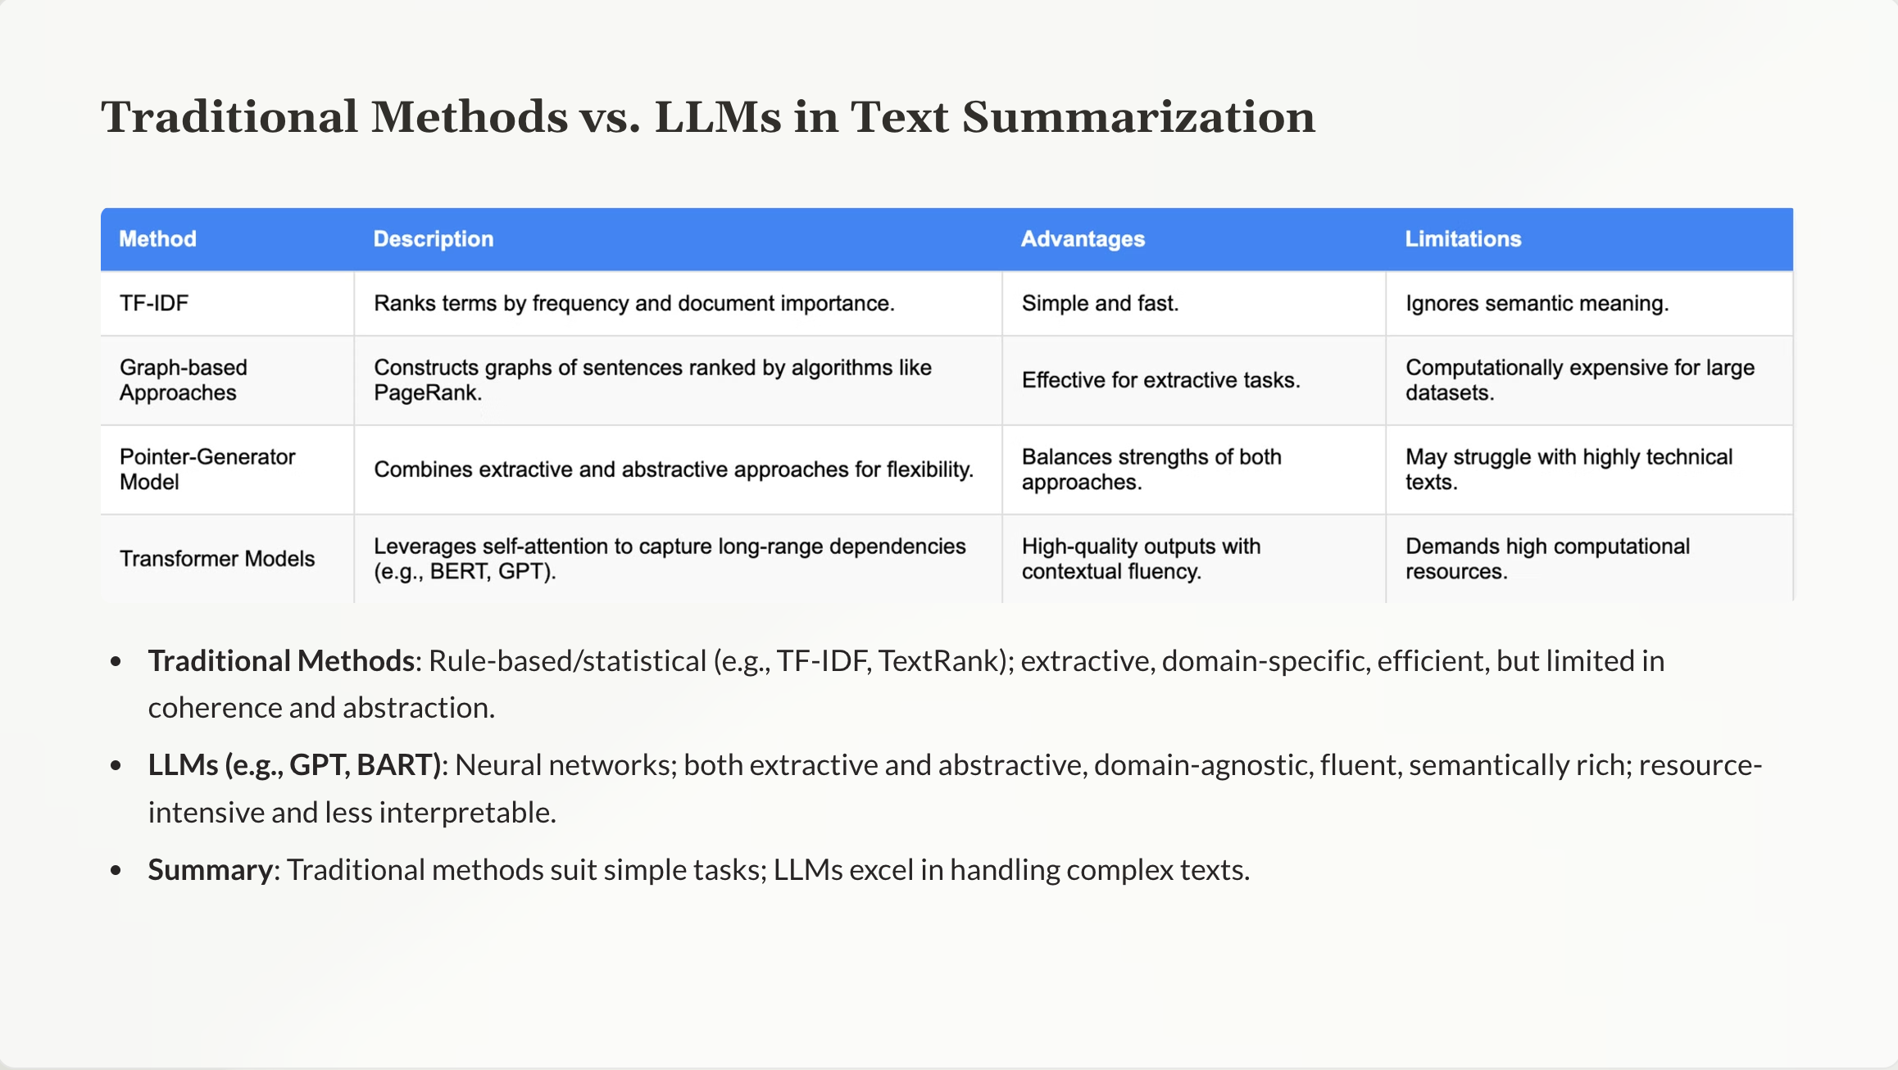
6

Slide 7
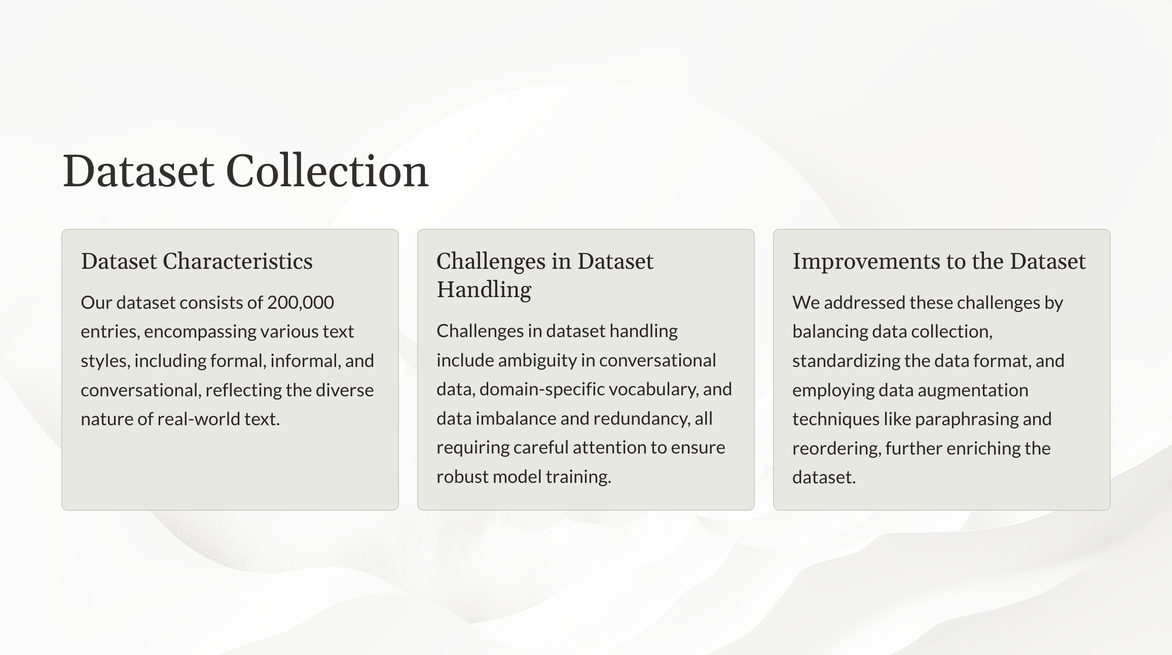
7

Slide 8
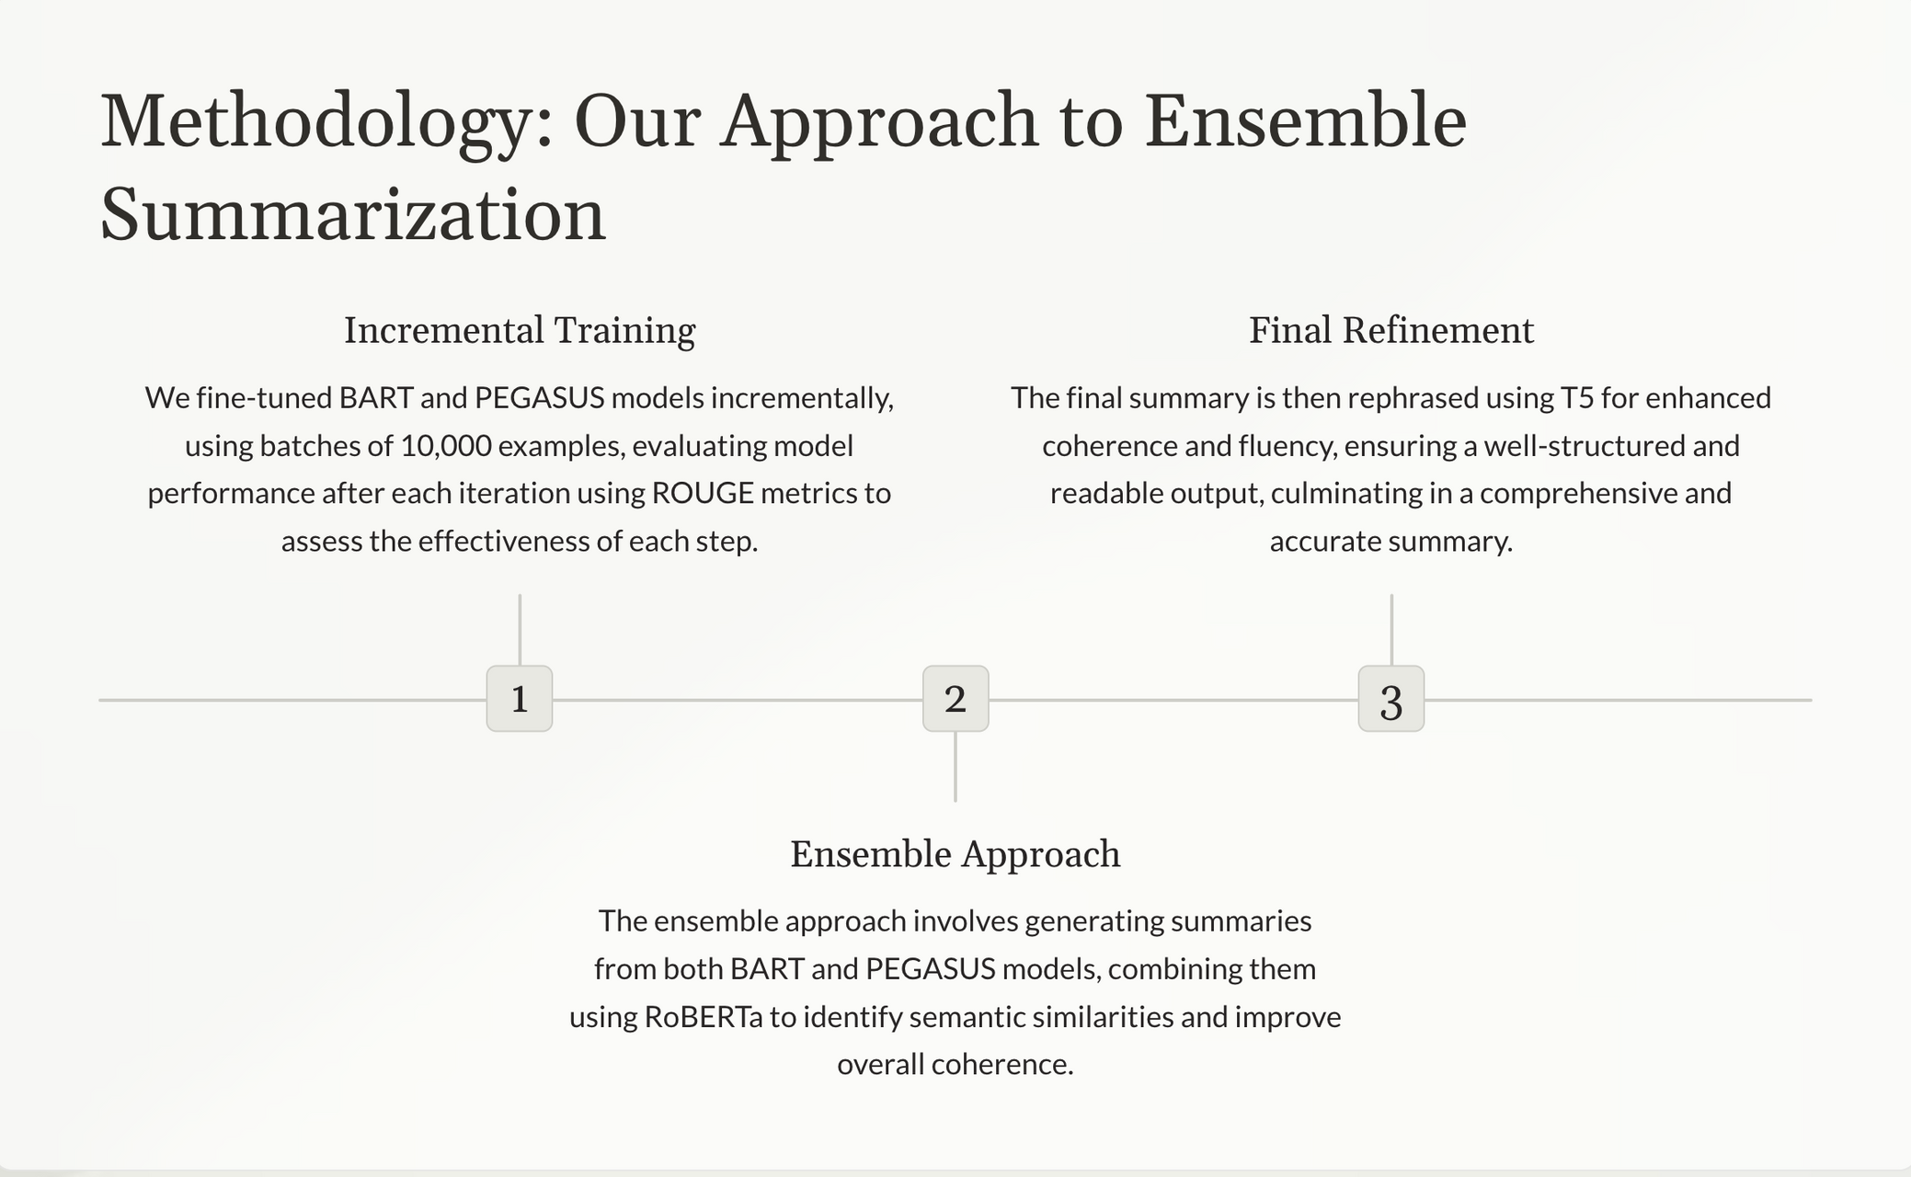
8

Slide 9
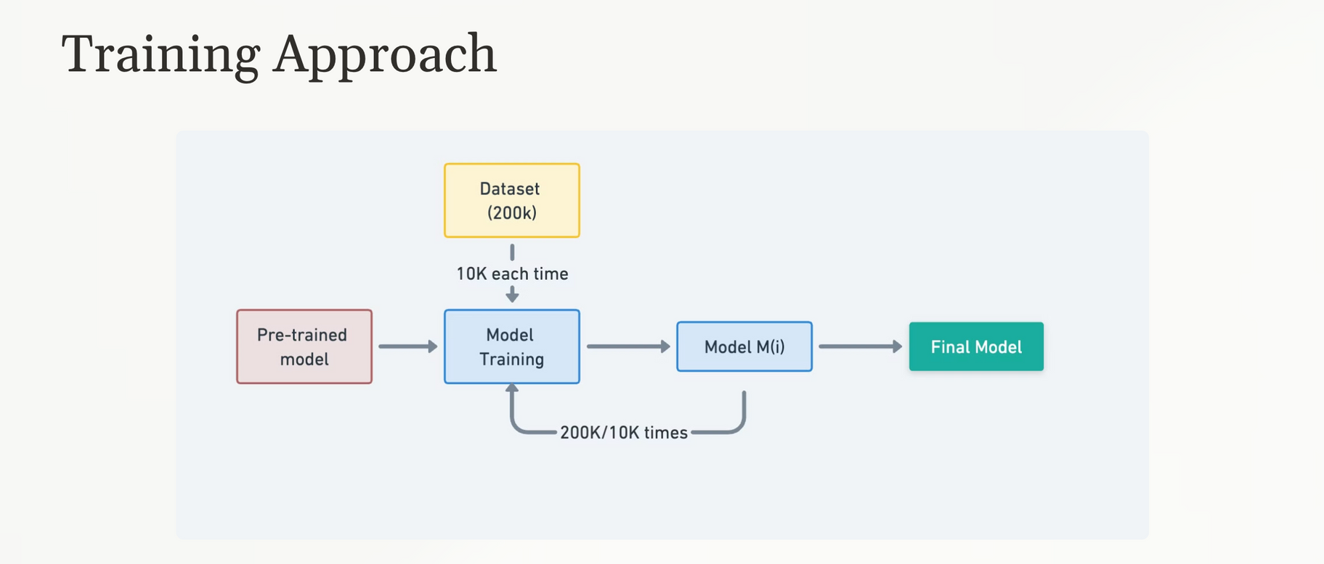
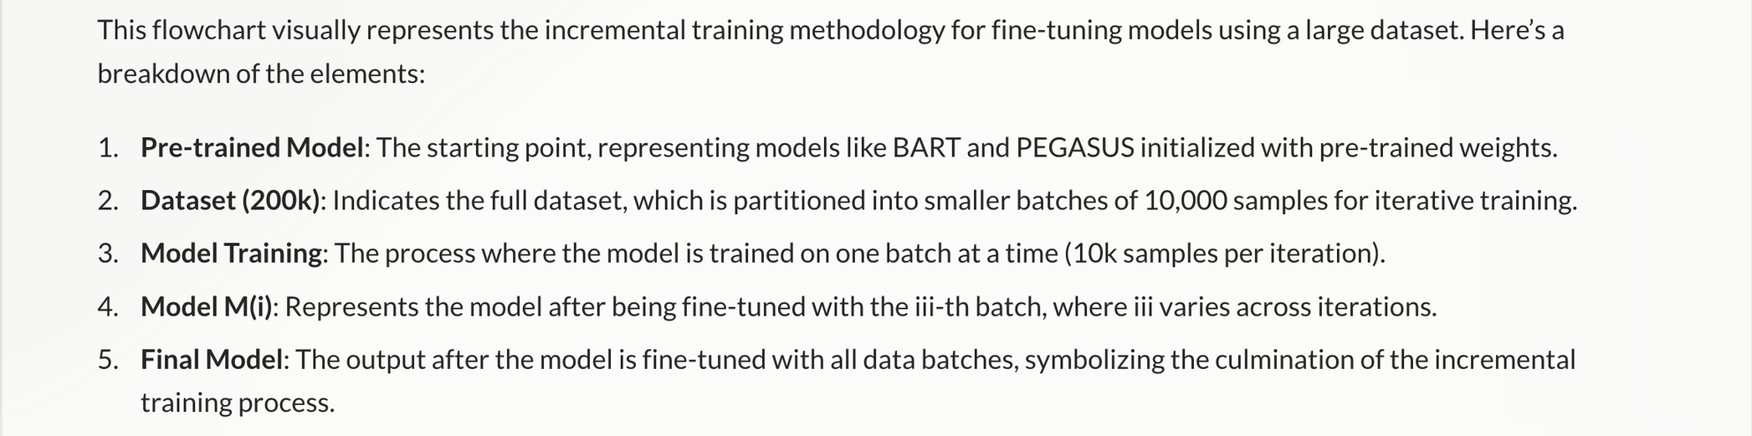
9

Slide 10
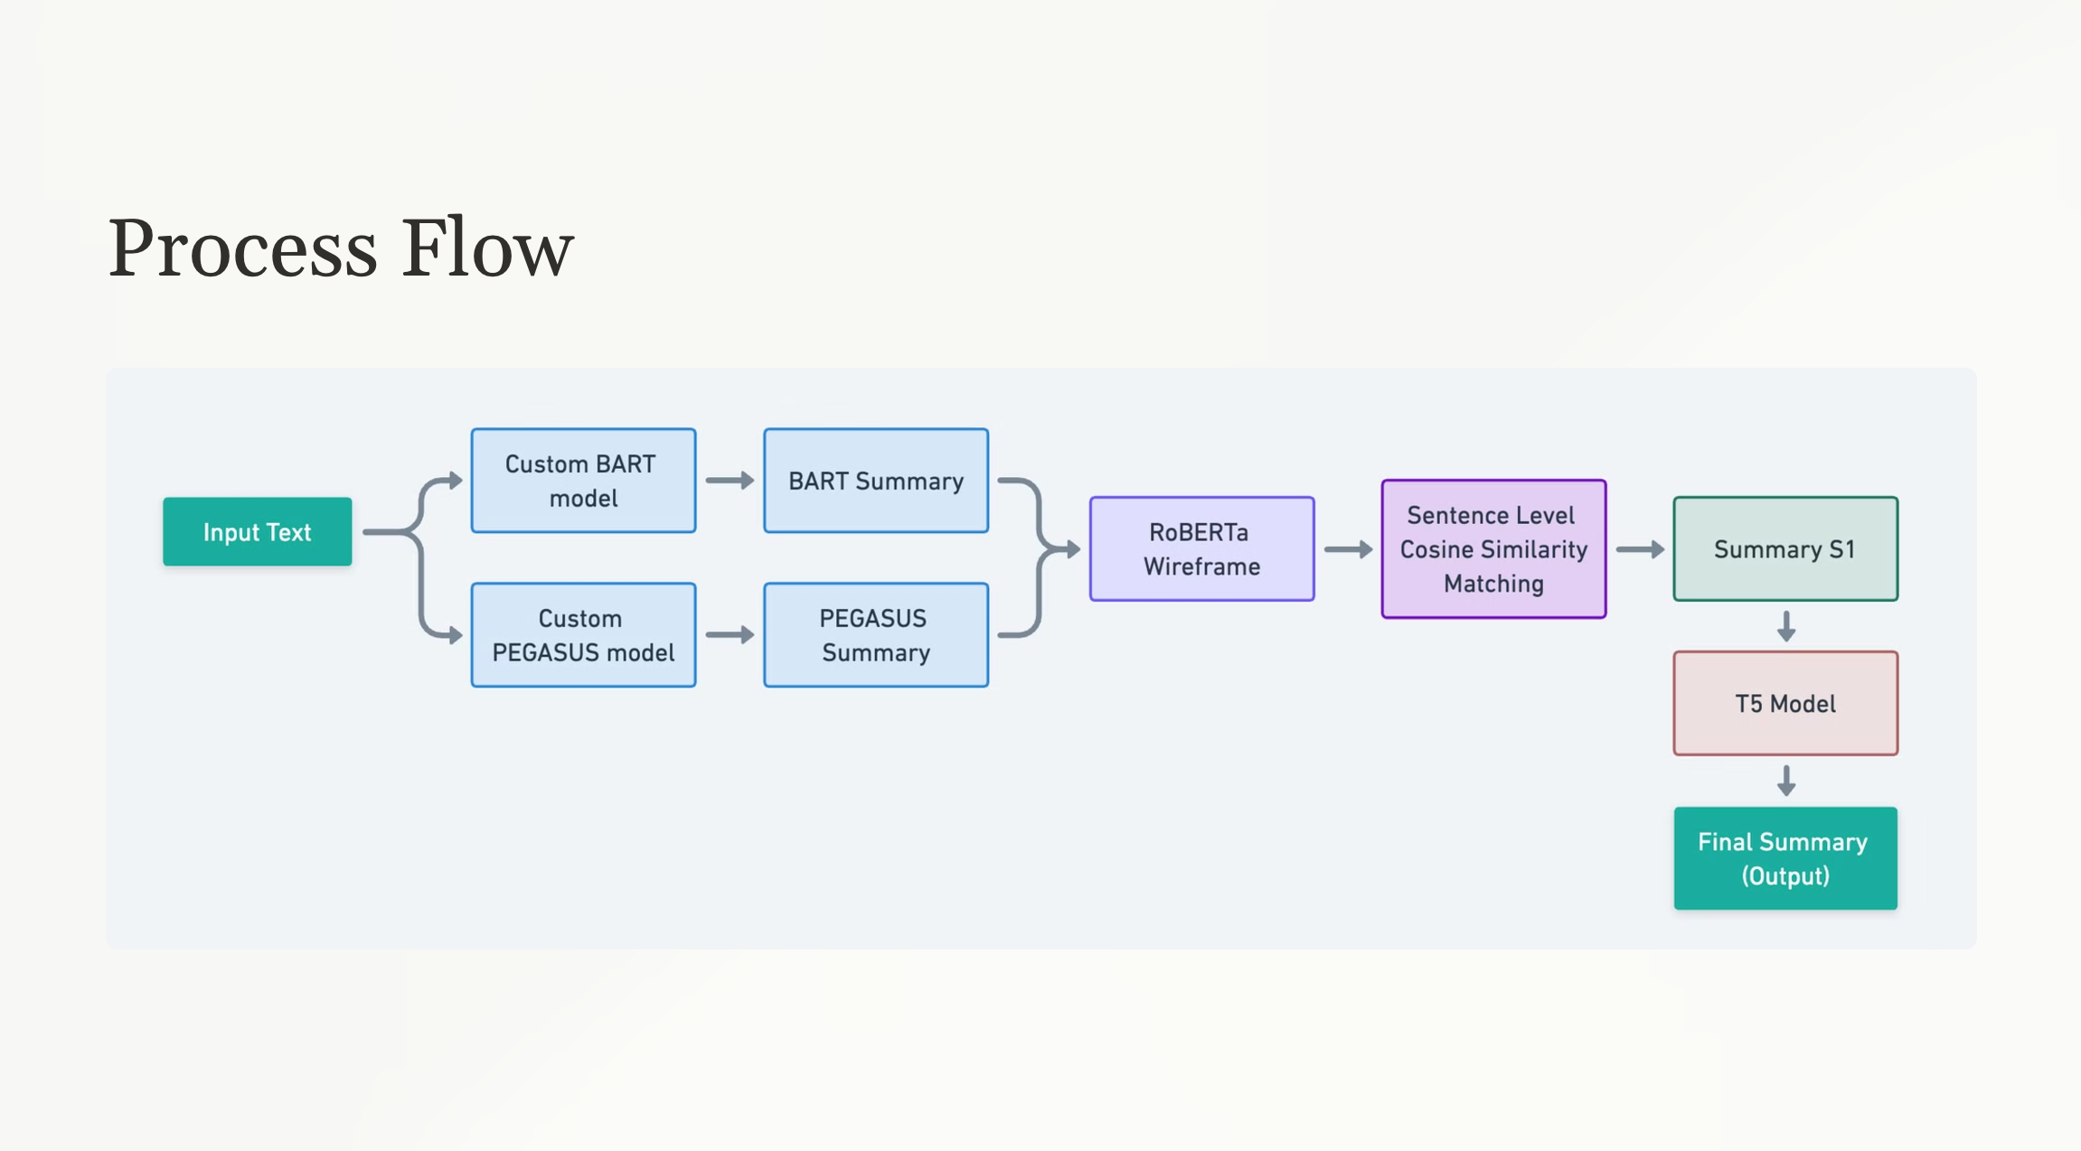
10

Slide 11
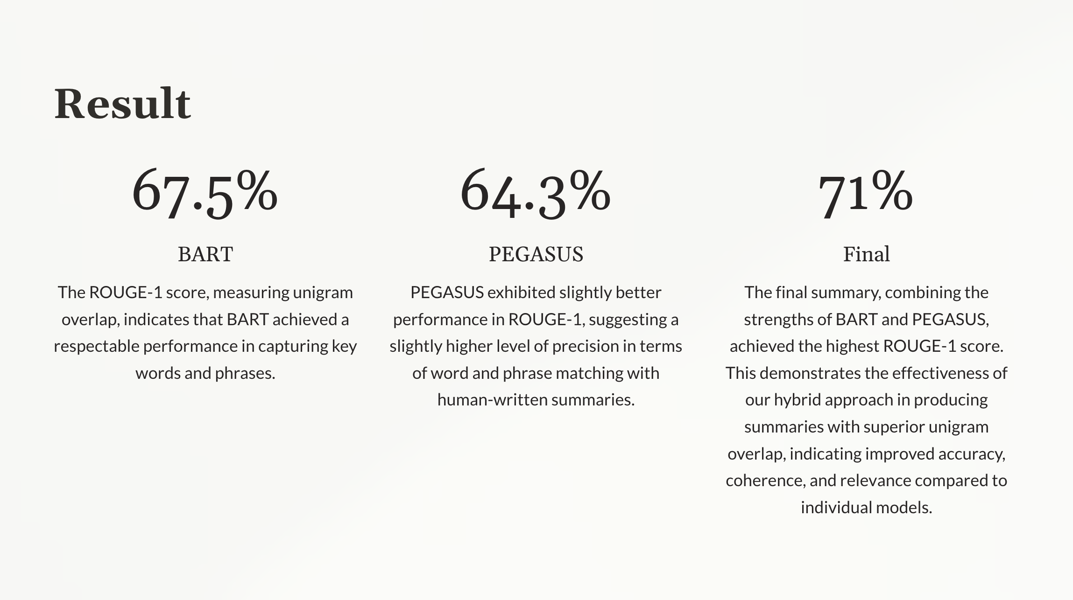
11

Slide 12
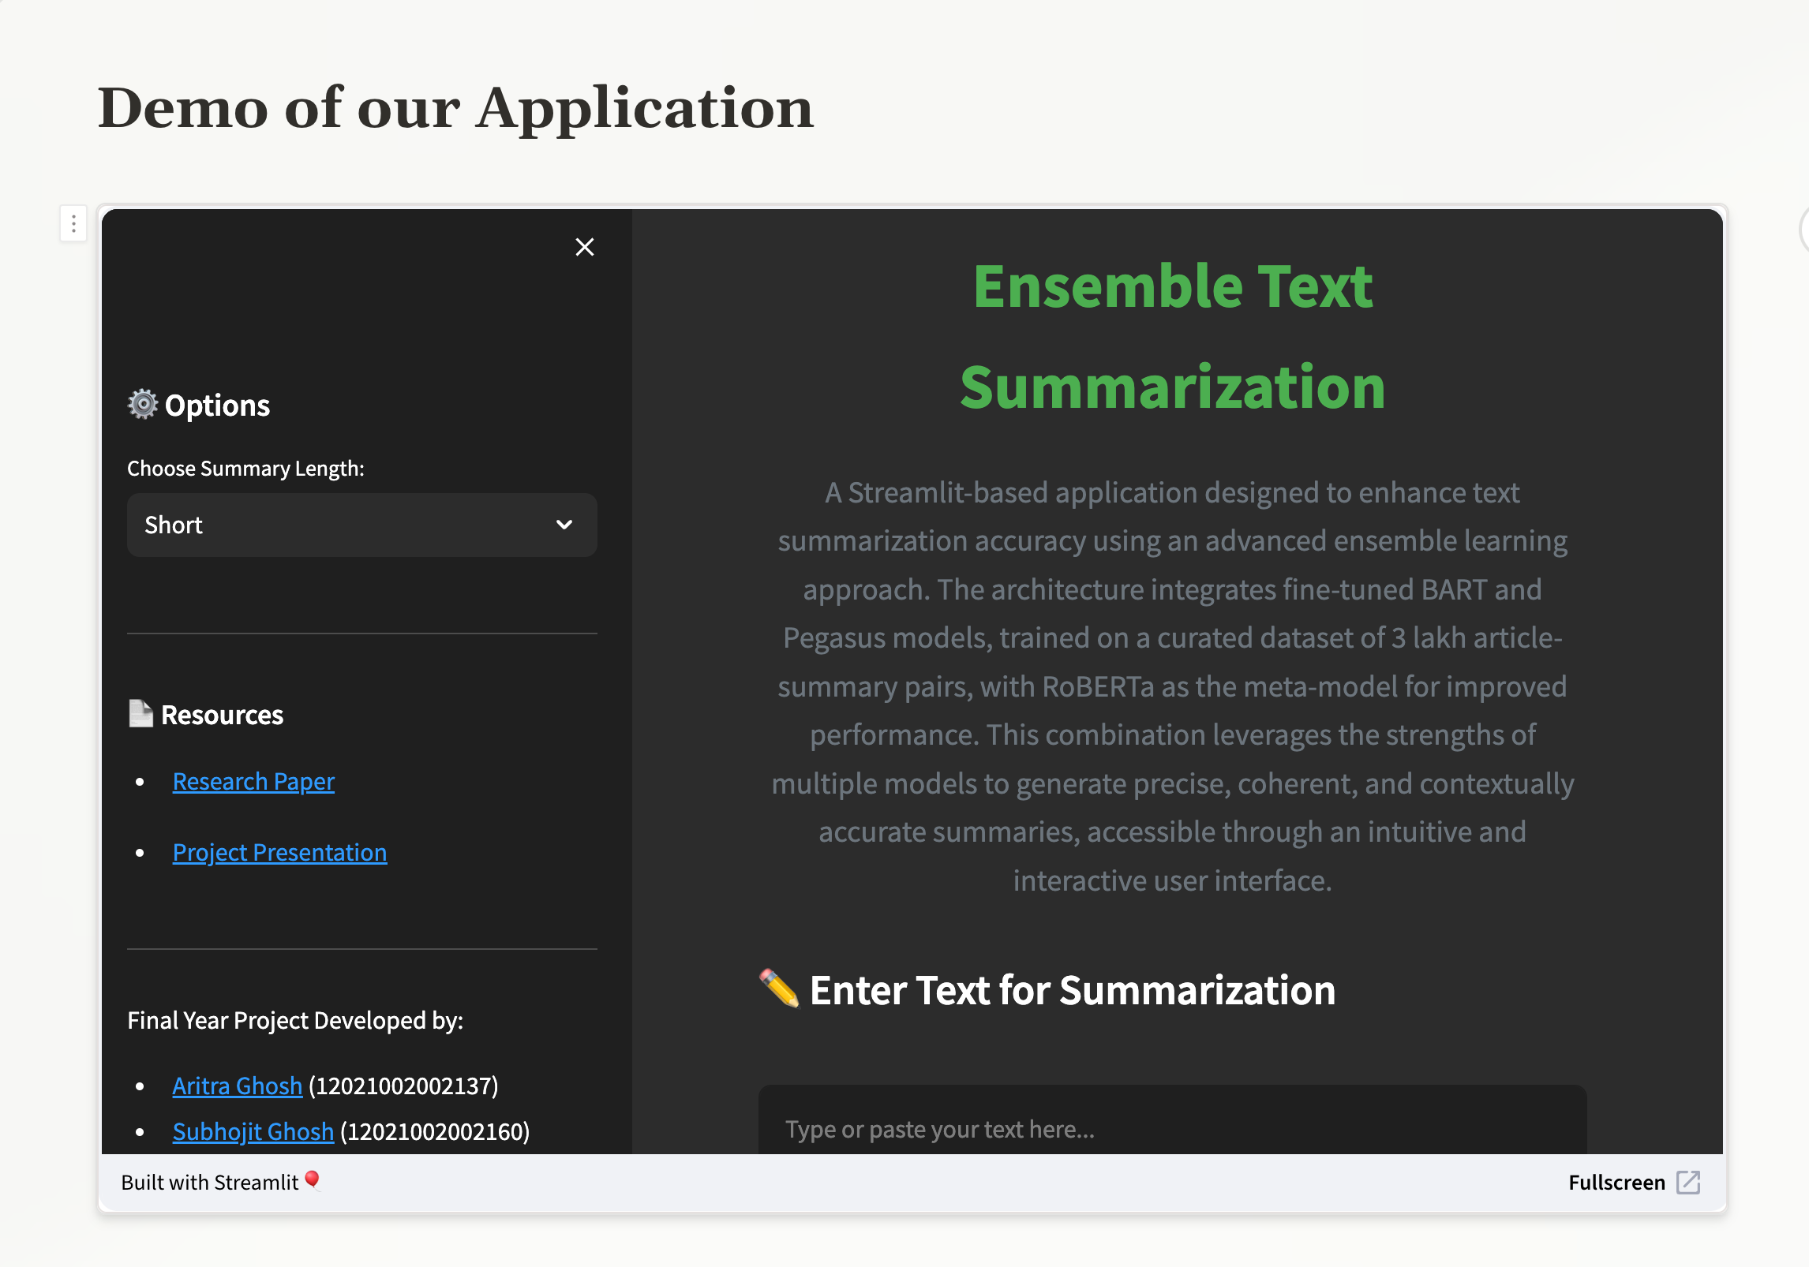
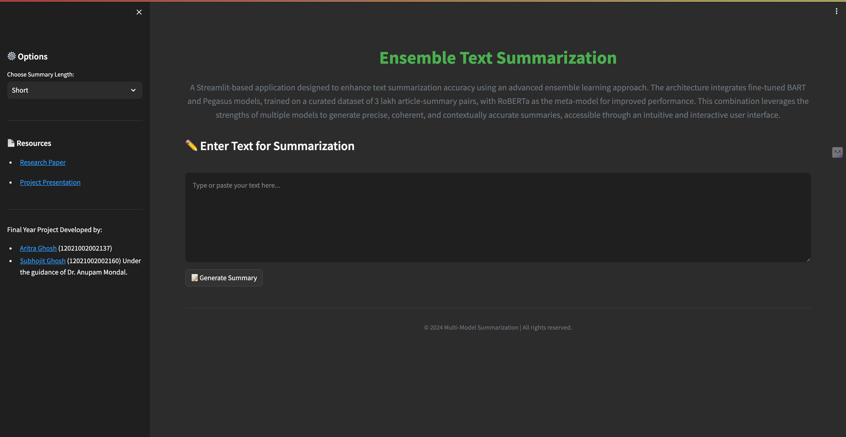
https://summari.streamlit.app/
12

Slide 13
Resources
GitHub Repo link: https://github.com/TheCleverIdiott/FYP
Paper1: https://drive.google.com/file/d/1l3rKsREM1euYFlapLcoAk8YpPqd43VgY/view?usp=sharing
Paper2: https://drive.google.com/file/d/1Bg0RTnMheb5lHD-xDwFDUcNVFDyvjRJF/view?usp=sharing
Project Report: https://drive.google.com/file/d/12iWuXNXkGBNk5PrK6mHJO6RL5Ohwa5jS/view?usp=sharing
Poster: https://drive.google.com/file/d/12iWuXNXkGBNk5PrK6mHJO6RL5Ohwa5jS/view?usp=sharing
13

Slide 14

14

Slide 15
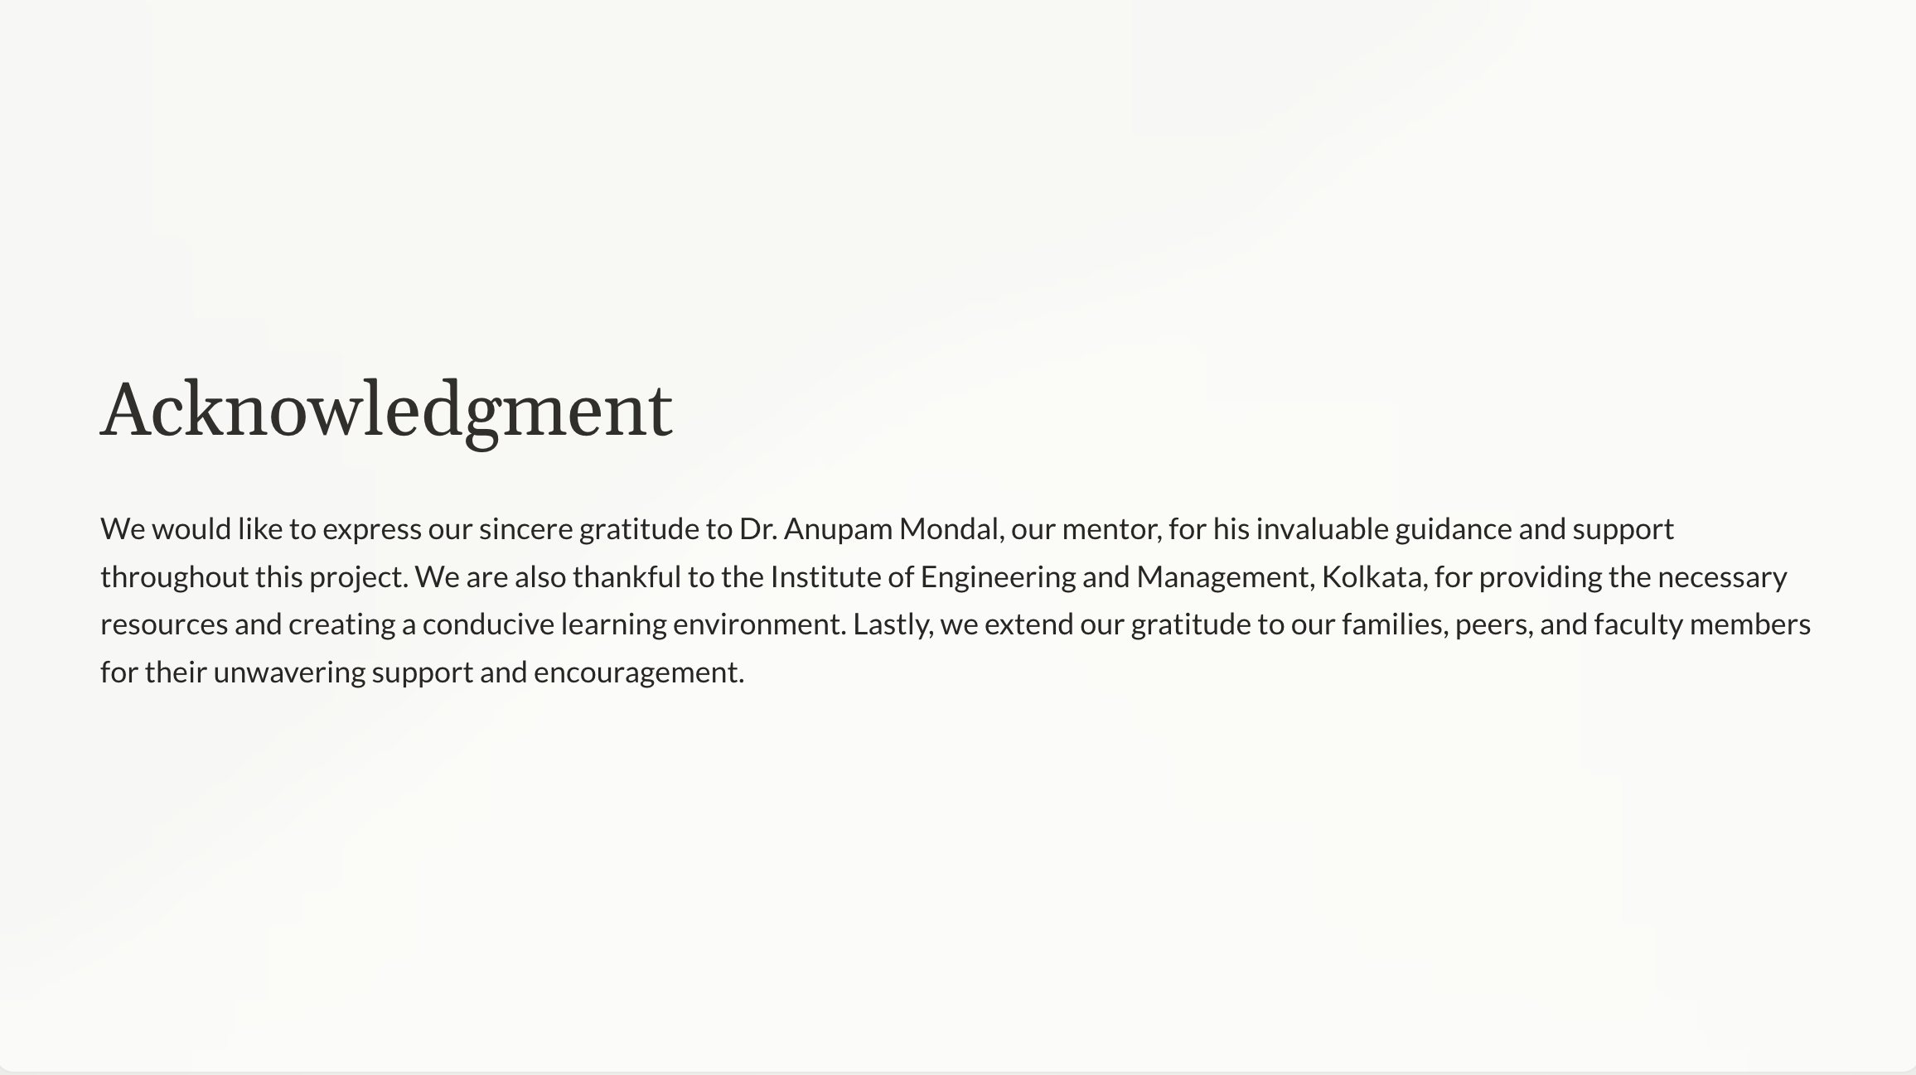
15

Slide 16

16

